Slide 1
Relaxation
Relax the body and the mind will follow!

Slide 2
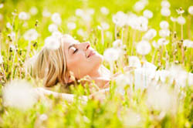
What is relaxation?
The word "relax" has its origin in the Latin word "relaxare" which means "to loosen".
a state of mind in which stressors, negative self-talk, and other worries are eliminated from the mind.
In psychology, relaxation is the emotional state of low tension, in which there is an absence of arousal that could come from sources such as anger, anxiety, or fear.

Slide 3

Relaxation training
Relaxation training is any method or activity that helps a person to relax, to attain a state of increased calmness or otherwise reduce levels of anxiety, stress or anger.

Slide 4
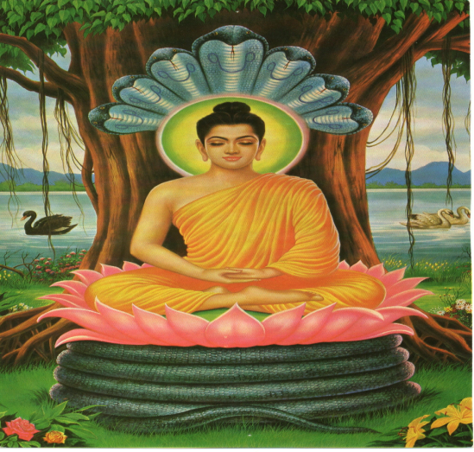
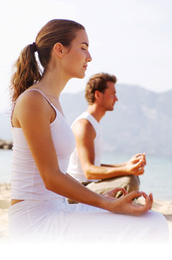
Historical background of relaxation techniques
Many of the relaxation practices are rooted in ancient religious practices including Christian and Jewish mysticism, Buddhism, and Islamic customs (Deleon 1999).
Meditation was among the first relaxation technique shown to have a measurable effect on stress reduction.
In the 1970s, self-help books teaching relaxation techniques began to appear on bestsellers lists.
In the mid-1980s, another well-known physician, Dr. Dean Ornish, incorporated an extensive relaxation program including meditation, yoga, and breathing exercises
Notes:
Introduce In Remembrance of God in Islam, which is known by the concept Dhikr is interpreted in different meditative techniques in Sufism or Islamic mysticism.^{[29][30]} This became one of the essential elements of Sufism as it was systematized traditionally. It is juxtaposed with fikr (thinking) which leads to knowledge By the 12th century, the practice of Sufism included specific meditative techniques, and its followers practiced breathing controls and the repetition of holy words
Meditative quiescence is said to have a quality of healing, and—in contemporary terminology—enhancing creativity and to gain introspection.
Christian Meditation is a term for form of prayer in which a structured attempt is made to get in touch with and deliberately reflect upon the revelations of God. focusing on specific thoughts (e.g. a biblical scene involving Jesus and the Virgin Mary) and reflecting on their meaning in the context of the love of God.[
. Visualization
Visualization or guided imagery is an effective Christian stress management technique that helps you relax as you imagine yourself out of the stressful situation
2. Singing
Singing is another effective Christian relaxation technique since it reduces tension. Singing Christian praises to God is even more powerful for managing stress than singing secular songs

Slide 5
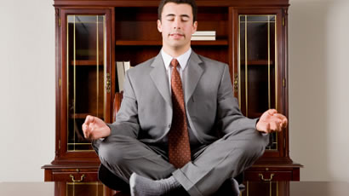
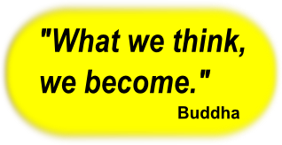
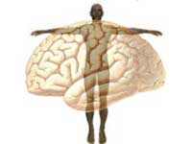
Mind and Body Connection
Firstly described by Dr. Herbert Benson of Harvard
Your body responds to the way you think, feel, and act.
Many ancient healing systems emphasize the interconnection between mind and body in healing, including Hippocrates, the father of Western medicine, who taught that good health depends on the mind-body connection.
Notes:
When you are experiencing poor emotional health, you may not be taking care of yourself as best as you can by exercising, eating right, or following your doctor's orders. A good goal for anyone, then, is to try to achieve the highest sense of well-being that is possible

Slide 6
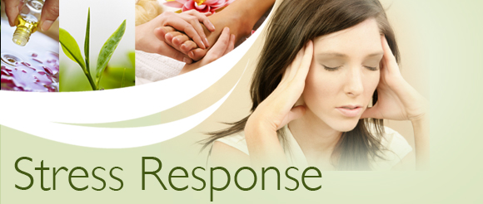
What happens when a person does not take proper rest?
Physiological Consequences
The nervous system will immediately kick in and become more active.
The blood pressure levels in the body will increase.
Development of coronary heart disease
Failure of vital organs – such as the kidneys, failure of the heart, and even stroke!
Notes:
If an individual does not take the proper time to relax, there comes an opposite response to the relaxation and its called stress response it can immediately begin to have a negative impact on the body. Stress response fight or flight response and sympathetic nervous system is active There are many different physiological consequences of stress.
When you’re under stress, your body releases hormones that produce the “fight-or-flight response.” Heart rate and breathing rate go up and blood vessels narrow (restricting the flow of blood). This response allows energy to flow to parts of your body that need to take action, for example the muscles and the heart. However useful this response may be in the short term, there is evidence that when your body remains in a stress state for a long time, emotional or physical damage can occur. Long-term or chronic stress (lasting months or years) may reduce your body’s ability to fight off illness and lead to or worsen certain health conditions.

Slide 7
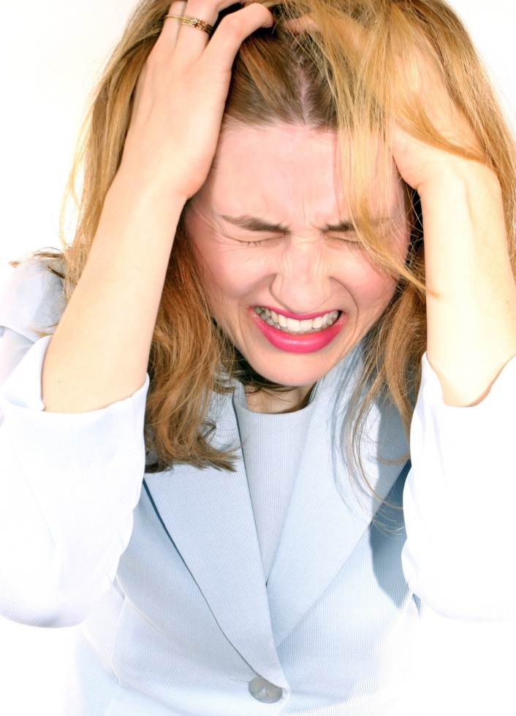
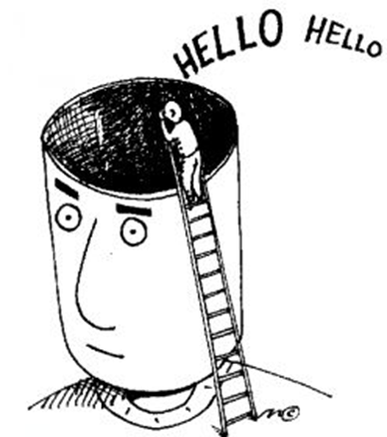
What happens when a person does not take proper rest?
Psychological Consequences
often affects the mental health of the individual
Some of the most common psychological symptoms include
Mood Swings
Mental Exhaustion
the Inability to Concentrate
Memory Retention Problems
Depression
Insomnia, and other sleep problems
Notes:
Mental illness refers to all of the diagnosable mental disorders and is characterized by abnormalities in thinking, feelings, or behaviors.
1.One time he may feel sad n lonely and other time happy or excited
2. a little mental work can cause tiredeness n fatigue
3. Problems in focus n think
4 past memories recall problems
5 sadness, unhappiness

Slide 8
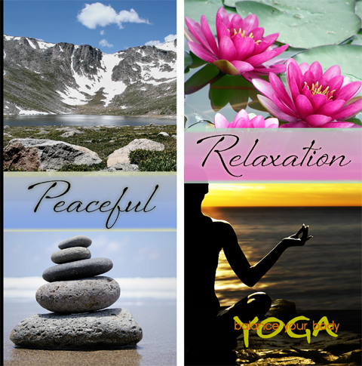
Relaxation Response
“The relaxation response is a physical state of deep rest that changes the physical and emotional responses to stress... and the opposite of the fight or flight response."
Herbert Benson
Relaxation works as a stress and anxiety cure, because it induces the opposite of the fight-or-flight response, and as a result causes the opposite symptoms.
a decreased heart and respiratory rate
deeper breathing
significant levels of alpha brain waves
a profound rested state
feelings of peace, satisfaction and inner balance
Notes:
According to Benson, in his book The Relaxation Response, the relaxation response is the process of de-escalating the stress response and inducing relaxation through activation of the parasympathetic nervous system. This is a normal and natural response that the body does automatically.
Reduce hyperactiveactvity

Slide 9
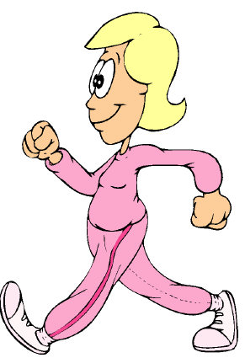
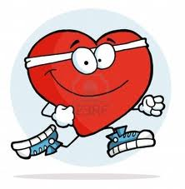
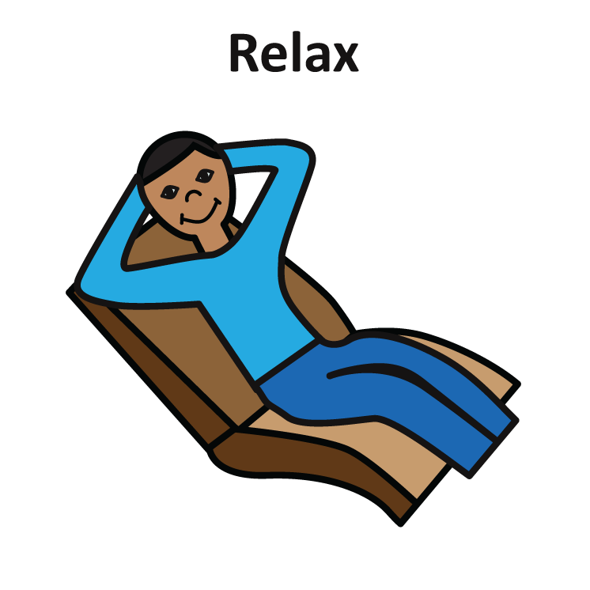
The Physiological Benefits of Relaxation
Energy levels are naturally increased
when an individual is relaxed.
The immune system develops and
grows stronger during relaxation.
Gives the heart a rest by slowing the heart rate and
reduces the risks of heart diseases
Lowered levels of cortisol like
adrenaline, it helps us deal with stress
Decreased high blood pressure
Notes:
So in relaxation state cortisol comes on its normal level Person feels himself more active and fresh One work may be possible in 15 min rather than 2 hours in stress
Taking the time to relax can help enhance your body's ability to fight off illness and disease more healthy
found college students have lower immune system function during periods of high stress, such as during and just after exams
Lowered levels of cortisol (hormone that is released in response to stress; like adrenaline, it helps us deal with stress, but too much can be harmful); and lactate-two chemicals associated with stress.
Reduces the workload of heart

Slide 10
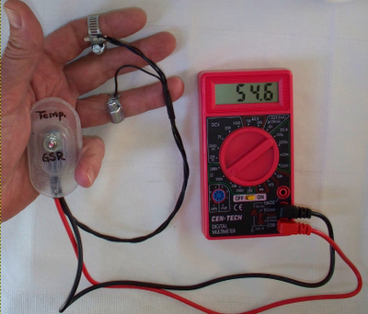
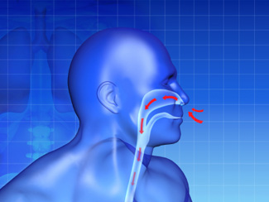

The Physiological Benefits of Relaxation
Slows the rate of breathing which reduces the need for oxygen increases blood flow to the muscles decreases muscle tension
Higher skin resistance.
Drop in cholesterol levels
Cure headaches and migraines
Studies have found that the use of relaxation imagery in smoking cessation programs to be effective.
Producing lasting beneficial changes in brain electrical activity
Notes:
. High cholesterol is associated with cardiovascular disease.
Low skin resistance is correlated with higher stress and anxiety levels. Decrease the brain waves and its activity and set its significant levels

Slide 11
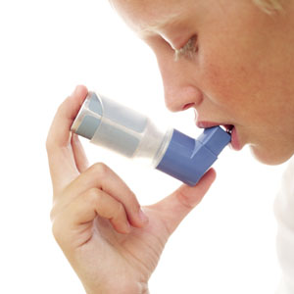
Relaxation and different diseases
Asthma
Relaxation treatments have been shown to produce significant improvement in asthma (Vazquez & Buceta, 1993), Facial muscle EMG BFK appears to successful in decreasing parasympathetically mediated bronchoconstriction.
Cancer
Relaxation techniques have been used to treat side effects of cancer therapy.
Relaxation training has been successful in decreasing the duration and severity of post treatment nausea (Morrow, 1986); and secondary insomnia (Cannici, Malcolm, & Peek, 1983).
Notes:
Deep breathing is effective in reducing bronchoconstriction

Slide 12
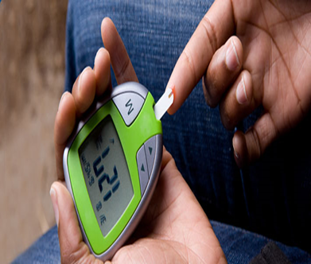
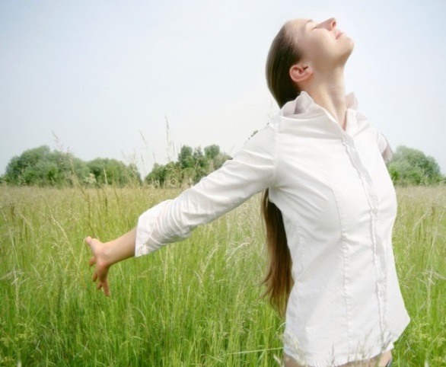

Diabetes
A recent study tested the hypotheses that persons with diabetes mellitus treated with twelve sessions of biofeedback-assisted relaxation would decrease blood glucose compared with untreated controls
HIV
Progressive muscle relaxation has shown to be quite effective in treating symptoms associated with HIV. Conditions such as anxiety, mood, self-esteem, and t-cell count were measured after a stress management program consisting of 20 bi-weekly sessions of progressive muscle relaxation was implemented.
Notes:
Similarly relaxtion tech is really effective for diabetes patients especially biofeed back fr ex in one study
Hiv aids patients experience many psychological symptoms i.e anxiety, stress, mood disorders , low self esteem
X pmr and guided imagery are found to be effective in reducing these symptoms and increase in the quantity of cd4 cells Relaxation techniques fr eStudies have also compared the effectiveness of guided imagery and PMR on HIV symptoms. Results have shown that imagery reduced depression and fatigue, while PMR increased CD4+T lymphocyte count and also reduced depression

Slide 13


Psychological Benefits of Relaxation
Individuals who take time to relax often have a more pleasant personality.
Smoother emotions — less anger, crying, anxiety, frustration
Increased concentration
By relaxing, you stand less of a
chance of developing depression.
Better problem-solving abilities
greater efficiency
Improved learning ability and memory
Increase creativity
Greater tolerance
Notes:
It assists in studying, enables faster comprehension, improves the memory, helps in focusing on a task, job, activity or goal, and therefore, achieving them more easily and efficiently
In a relaxed state person deals with his problems in a more better way
During relaxation Mind is fresh and active it increases self esteem and self confidence
New ideas Imagination, innovation relaxation really necessary for artists,
More patient and more relaxed more control over their emotions and feelings

Slide 14

Relaxation Procedure

Slide 15
Preliminary Steps
Check that individual is suitable for relaxation response
Ensure conducive environment
Ensure staff/caregiver support is available
Gear the relaxation to the level of functioning

Slide 16
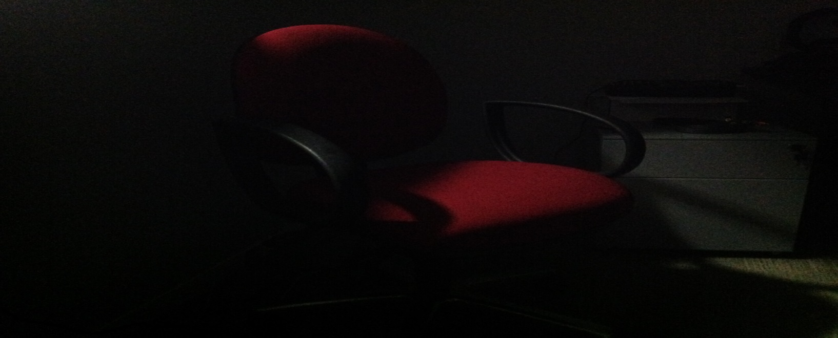
Step 1: Preparing Yourself
1. Sit in a comfortable chair with headrest.
2. Let the chair support you and become comfortable.
3. Take glasses (or contacts out); loosen clothing, no gum.
4. Dim any strong sources of light, particularly on the eyes.

Slide 17
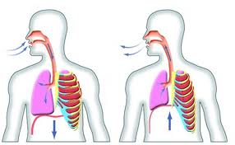
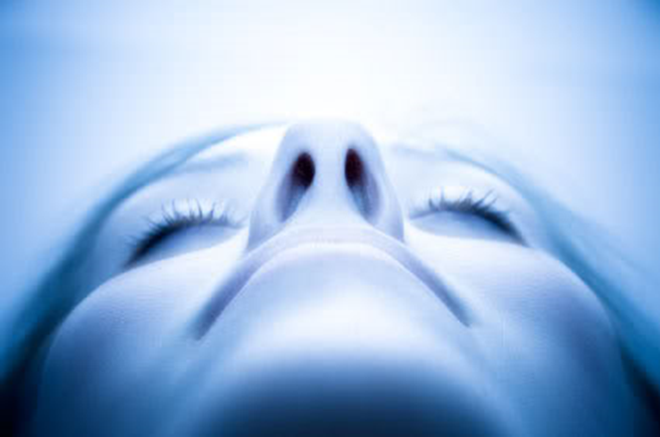
Step 2: Internalizing Attention
1. Take several deep cleansing breaths
2. Allow your eyes to close and begin to focus your
attention within your body
3. Experience various subtle sensations or feelings in
various parts of your body that ordinarily you are
not aware of.

Slide 18
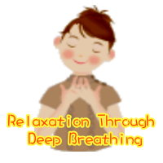

Step 3: Regulating Breath
1. Turn your attention internally to your breathing.
2. Establish a slow, steady rhythm for breathing and
maintain it.
3. Experience this rhythm using a visual image, for
example, a light that glows brighter, when you
inhale and that dims when you exhale.

Slide 19
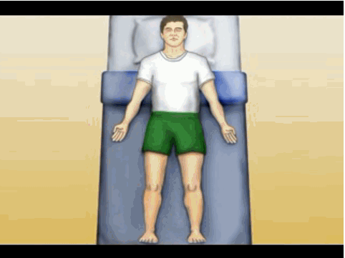
Step 4: Muscle Relaxation
1. Sense throughout your body for any areas of
tension, pressure, or discomfort.
2. Focus your attention internally on each of these
areas in turn.
3. Feel/experience these areas more relaxed and
visualize them as totally tension‐free.

Slide 20
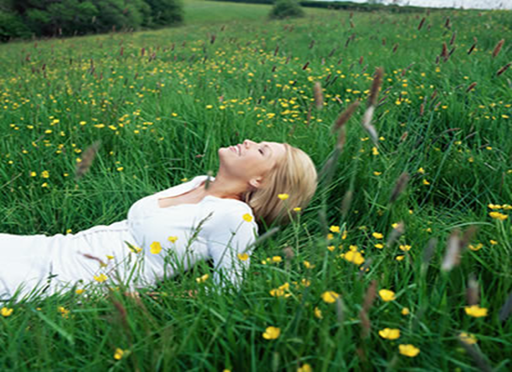
Step 5: Imagery Involvement
1. Visualize yourself in a relaxed environment using
your own relation imager.
2. Experience total sensory involvement in that relaxed
environment, for example, sight, sounds, smells,
tactile sensations and feelings.

Slide 21

Step 6: Returning to Full Alertness
1. Visualize yourself at the bottom of five steps ready
to climb to the top.
2. Count slowly to yourself from 1 to 5 as you climb
each step.
3. While pausing at each step, give yourself positive
suggestions.
Notes:
Repeat the 5 steps

Slide 22

How To learn Relaxation
Relaxation is a skill.
Each person has the ability to learn how to relax,
but not everyone will relax the same way.
Learning to relax can take a bit of practice. You have to be open minded and be willing to give it a fair go, but the end result can be very rewarding.
Like any skill, relaxation takes time. With practice, your body learns to associate key actions, such as taking a deep breath or clenching your fist, with a deep relaxation response. As your skills develop, you will be able to relax anywhere – in the car, in the shopping centre, or while waiting in a queue.
Notes:
This learned response allows you to relax more deeply and more easily, in a variety of situations, as you use the technique day-by-day.

Slide 23
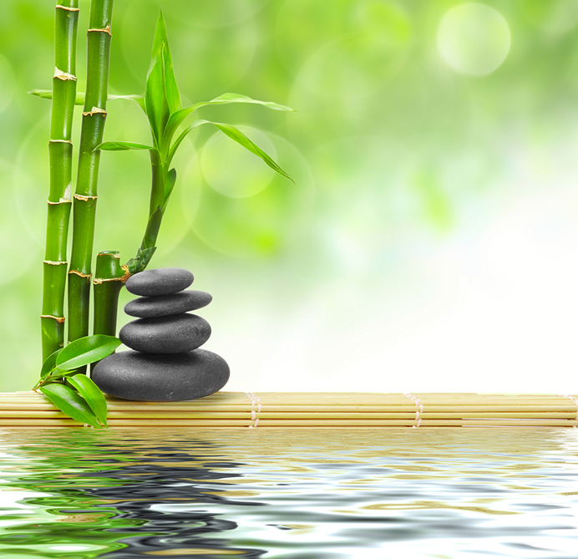
Relaxation techniques

Slide 24
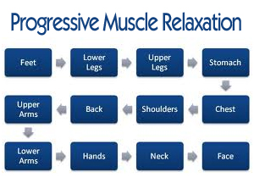
Progressive Muscle Relaxation
American physician Edmund Jacobson developed in 1920s
Involves alternating tensing and relaxing the muscles
Muscles are tensed (10seconds) and relaxed (20 seconds) through various parts of the body
PMR entails physical and mental component
More effective for anxiety patients and popular with modern physical therapists
Notes:
Progressive relaxation
In progressive relaxation, the person focuses his or her attention on individual muscle groups and tries to tighten and relax each of the muscle groups one after the other. It is also known as "Jacobson’s progressive relaxation" and, according to experts, it can also be used in combination with guided imagery and breathing exercises

Slide 25
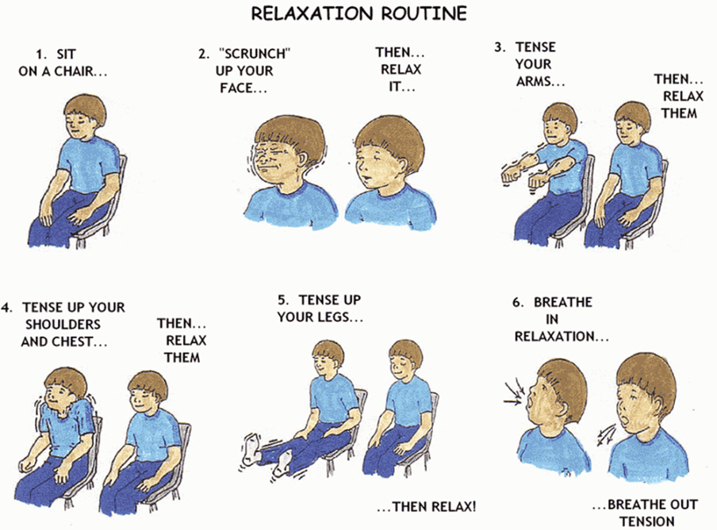

Slide 26
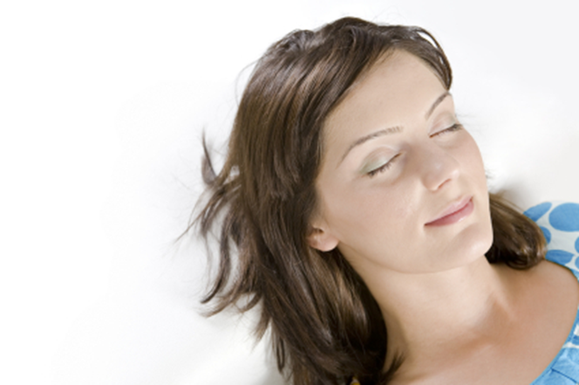
Passive Muscle Relaxation
Passive muscle relaxation does not involve tensing muscles
You imagine that your muscles are in a relaxed state
Thinking about relaxing them sends a signal to the brain to relax the muscles
A better form of relaxation for those with high blood pressure, cardiovascular illness or chronic pain
Notes:
Research has shown that just thinking about a stressor can cause muscles to tense,often helpful for those with chronic pain problems as it aims to avoid muscle tension

Slide 27
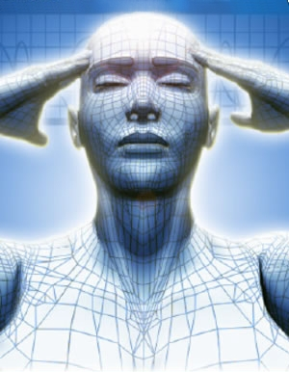
Visualisation/Imagery
Another technique for inducing the relaxation response, it also improves physical and psychological health
It is especially useful for those with an overactive mind.
In this technique we use all our senses of smell, touch, etc to imagine a peaceful, relaxing scene.
Mostly used with combination of some other techniques
Notes:
Guided imagery
In this method, a practitioner or the person him or herself will enable visualizing scenic images or images that will promote calmness in the mind. A practitioner may use storytelling to enable such visualizations, while well-written descriptions could also make a person visualize mental images that will promote similar influences on the person's mind and on the body.

Slide 28
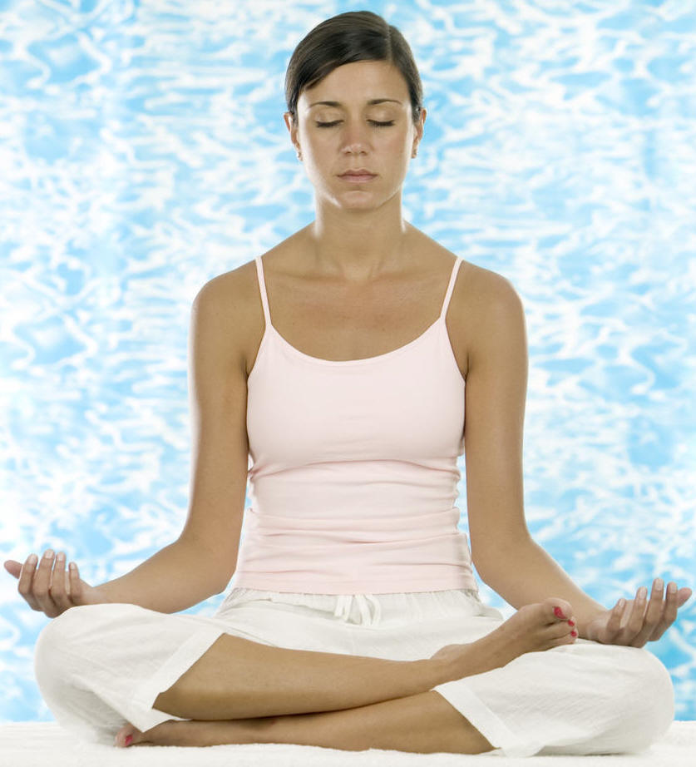
Meditation
Involves deep breathing and concentration
Allows tension to leave the body with exhalation.
Forms:
- sitting quietly for 20 minutes
- focusing on a word or symbol whilst controlling breathing.
Notes:
Learning to quiet the noise in the body through relaxation techniques greatly enhances our successful practice of meditation.

Slide 29
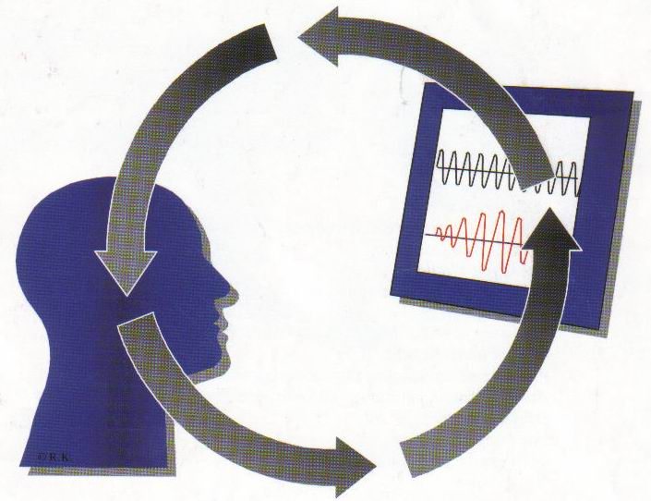
Biofeedback
Uses instruments which measure changes in bodily functions.
Instruments can measure changes in:
- Skin temperature
- Sweating
- Heart rate
- Breathing
- Muscle activity
- Brain waves
Notes:
Biofeedback
The concept of biofeedback is based on giving the person the ability to control his or her physiological processes, such as the heart rate and other bodily functions. In this technique, electronic devices act as sensors and provide the person with information related to bodily functions, as well as the ways to influence the same, to gain a relaxed state. Thus, the method is seen as a way of controlling manifestations related to stress.

Slide 30
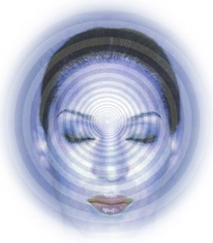
Hypnosis
This technique can be used to induce states of relaxation.
It is induced by a person whose suggestions are accepted by the subject
It can help to control anxiety and improve or alter behavior.
Used on client to improve focus, motivation, confidence or to help control nervousness, tension or anxiety.
Similar to autogenic training and meditation.
Notes:
In self-hypnosis, the person concerned will mimic a hypnotic state by using a phrase or a non-verbal cue known as a "suggestion." Such methods have become popular in relieving pain, as in the case of tension headache, labor pains and pains associated with minor surgeries. It has also been used to treat anxiety and irritable bowel syndrome.

Slide 31
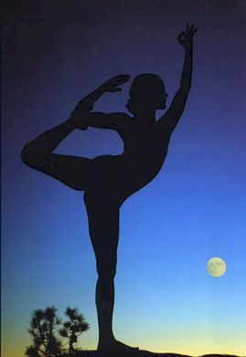
Yoga
An Indian technique of postures to induce flexibility and relaxation
Involves breathing exercises and physical exercises
Improves the function of body
Leading to better breathing
Increased muscle tone
Released stress
Notes:
Research on yoga has shown that it helps to lower sympathetic nervous system arousal, lower blood pressure and lower levels of stress hormones such as cortisol, to name a few of its health benefits. Your local Adult Education Centre will run beginners courses in Yoga should you decide to use this technique.

Slide 32
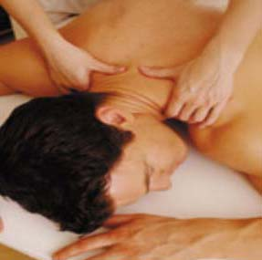
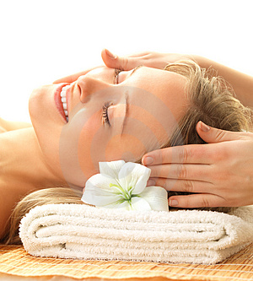
Massage
Massage involves a wide variety of techniques such as acupressure, deep tissue massages and Indian head massages etc.
Relieves muscle tension
Improves flexibility

Slide 33
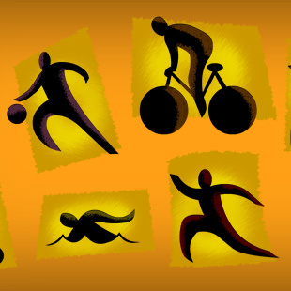
Exercise
Can improve mood state
Reduce muscle tension
Light, aerobic exercise
Examples:
- Going for a light jog
- Doing exercises such as swimming, walking

Slide 34

Music
Involves listening to music which motivates them or acts to relax them

Slide 35
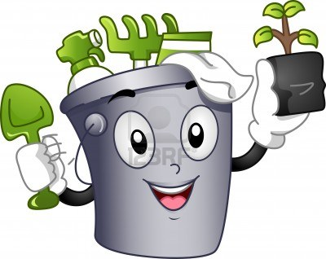

Hobbies
Any activity that you find relaxing and slows the body and mind
Examples:
  1. Reading
  2. Playing a musical instrument
  3. Gardening

Slide 36
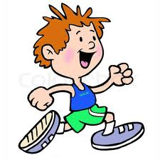
Humor
Laughing is the best way to relieve tension.
Distract away from the pressure to perform well.
Reduce stress

Slide 37
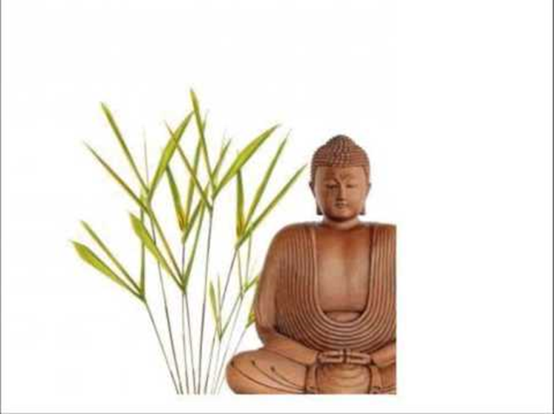
Autogenic Training

Slide 38
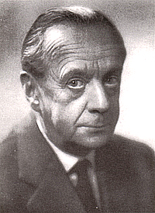
What is autogenic training
It was developed by a German psychiatrist Johannes Schultz in the 1920s.
Autogenic training (AT) or autogenics is a relaxation method, often referred as Western meditation.
This technique uses both visual imagery and body awareness to move a person into a deep state of relaxation by different suggestions.
Once learned, these suggestions allow you to achieve deep relaxation in just 10 minutes.
Notes:
Autogenic relaxation is a form of self-hypnosis in which the person imagines they are calm and their limbs and body are heavy, relaxed and warm. If you choose autogenics it would be an idea to be taught by an autogenics practitioner
. This method involves repeating certain mental directives and concentrating on them until the body responds. An example of this would be "My arms are heavy and warm" and focus on the sensation of the arms feeling heavy and warm.

Slide 39
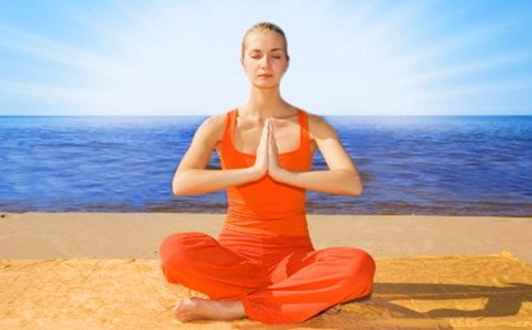

This technique relies on feelings of heaviness and warmth in the muscles given via self-suggestion.
Feelings of heaviness in the limbs helps to decrease muscle tension
Feelings of warmth help to dilate the blood vessels.
3 main parts:
Creation of feelings of warmth and heaviness
Use of imagery to conjure relaxing senses which is accompanied the feelings of warmth and heaviness
Use of specific themes to assist in causing relaxation (self statements that body is relaxed)
Notes:
Expand and wide

Slide 40
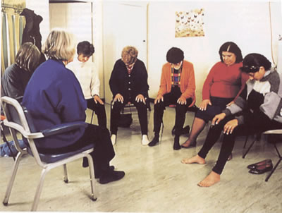
Autogenic Training Session
Daily practice of sessions that last around 15 minutes, usually in the morning, at lunch time, and in the evening
Each session can be practiced in a position chosen amongst a set of recommended postures
During each session, the practitioner will repeat a set of visualisations that induce a state of relaxation
Notes:
for example, lying down, sitting meditation, sitting like a rag doll)

Slide 41
Example of an autogenic training session
Sit in the meditative posture and scan the body
"my right arm is heavy"
"my arms and legs are heavy and warm" (repeat 3 times)
"my heartbeat is calm and regular" (repeat 3 times)
"my forehead is cool"
"my neck and shoulders are heavy" (repeat 3 times)
"I am at peace" (repeat 3 times)
Finish part one by Cancelling
Start part two by repeating from step 2 to Cancelling
Start part three by repeating from step 2 to Cancelling

Slide 42
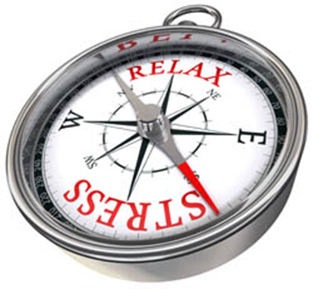
How does autogenic training work?
During the practice of autogenic training your stress response is switched off and the so-called "fight or flight" mechanism is replaced with the "rest and digest" phase.
Autogenic training uses simple mental exercises, which are practiced in a passive mental state.
.
Autogenic training, which uses suggestive phrases directed at certain parts of the body, is different from meditation techniques, which use mantras repeated silently
Notes:
During the rest and digest phase, your blood flows into your abdomen, stress hormones are lowered, blood pressure drops, immune system strengthens, and you can enjoy all of the positive effects of a relaxed state.
. For instance, when we practice autogenic training the suggestion of heaviness in the limbs together with passive concentration, brings about deep relaxation. The phrase in this case is: "My arms and legs are heavy."

Slide 43

What benefits does autogenic training have?
Regular practice of autogenic training enables you to withstand higher stress levels than a person not practicing any form relaxation.
Can also affect your gene expression, which leads to additional positive effects
In the long-term you become a more rational, calmer person
Notes:
Practicing autogenic training for longer periods of time (i.e. 10 or more years) can also affect your gene expression, which leads to additional positive effects. In the long-term you become a more rational, calmer person. You also look at situations in your life differently, with less anxiety and a more positive outlook. Balanced and pleasant

Slide 44

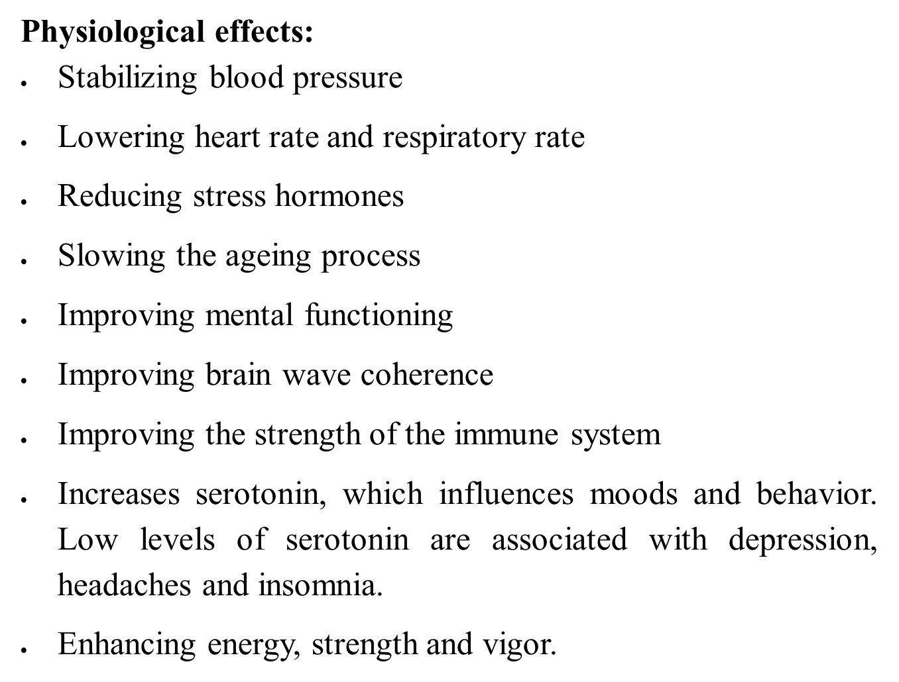

Slide 45
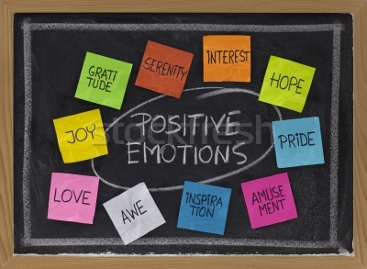

Psychological effects:
Decreasing stress, anxiety, anxiety attacks, and depression
Decreasing the fear of death
Increasing the joy of living
Increasing positive emotions and attitudes towards life
Increasing self-confidence
Notes:
Fear of death especially in terminally ill patient it’s a most common response

Slide 46

Cognitive effects:
Increasing concentration and strengthening the mind
Increasing memory

Slide 47
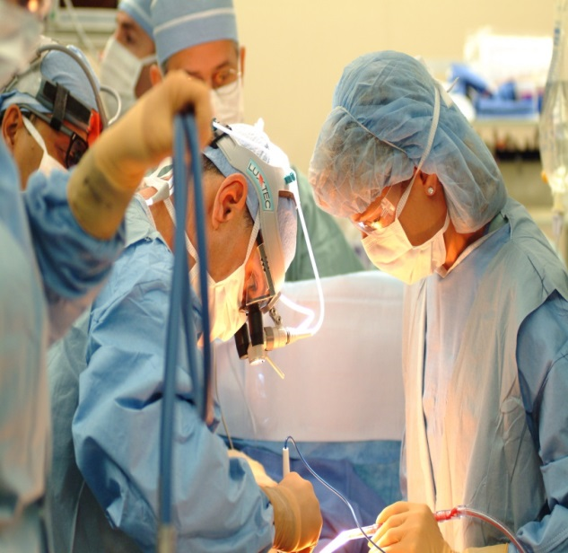
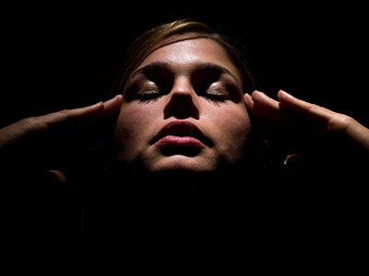
Autogenic training today
Today autogenic training has several activity centres throughout the world (including Japan, Germany, and the UK) with the same core of six standard exercises.
It also helps in:
Surgery
Cancer Treatment Support
HIV
Headaches
Notes:
Broader public is unaware of its usefulness and effectiveness
One study suggests that the use of visualizations prior to surgery cannot only reduce the need for pain medications, it can also help prevent hematomas (collections of blood under the skin)
self-hypnotic relaxation experienced significantly less pain and anxiety during an uncomfortable, invasive procedure than similar patients receiving only empathetic or usual care
hivThe standard treatment for HIV is highly active antiretroviral therapy (HAART). Often people who take HAART have gastrointestinal (GI) side effects, like diarrhea and nausea. In one study, 130 HIV patients on HAART were randomized to receive 1 ofA careful review of 20 trials found psychological interventions such as cognitive behavioral therapy, biofeedback, relaxation and coping were associated with reduced chronic headache or migraine 4 treatments: acupuncture plus relaxation therapy,
Autogenic training can help treat migraines by reducing both their severity and occurrence. The cause of migraines is again where the solution lies - if stress is the cause of a migraine, autogenic training can help.
in reducing their anxiety, depression, stress, and fatigue in hiv aids patients

Slide 48
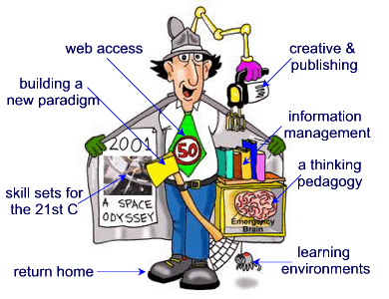

Relaxation and Today’s Life
Too Busy to Relax..
Times of tremendous growth and prosperity also require that you grow and adapt with them. Sometimes it is difficult to keep up with such a fast-paced and ever changing society, so it is very important to learn and utilize skills that will help you succeed in the 21st century.

Slide 49

Use of Relaxation Techniques for Health in the United States
According to the 2007 National Health Interview Survey,
12.7 percent of adults used deep-breathing exercises,
2.9 percent used progressive relaxation, and
2.2 percent used guided imagery for health purposes.
Most of those people reported using a book to learn the techniques rather than seeing a practitioner.
Notes:
Relaxation techniques as part of a comprehensive plan to treat, prevent, or reduce symptoms of a variety of conditions including stress, high blood pressure, chronic pain, insomnia, depression, labor pain, headache, cardiovascular disease, chemotherapy side effects, and others.

Slide 50
Tips for Doing Relaxation
Set aside 30 – 45 minutes
NOT after a meal
Quiet, distraction-free environment
Dim lights
Normal temperature
Loose clothing
Lie down or sit in a comfortable chair

